Slide 1

Unit IV Project Management: Process, Metrics, Estimations & Scheduling
Prof. M.P.Karnik
madhuri.chavan@viit.ac.in
Department of Computer Engineering
BRACT’S, Vishwakarma Institute of Information Technology, Pune-48
(An Autonomous Institute affiliated to Savitribai Phule Pune University)
(NBA and NAAC accredited, ISO 9001:2015 certified)

Slide 2
Project Management Concepts-The Management Spectrum, People, Product, Process, Project, The W5HH Principle
Metrics in the Process and Project Domains, Software Measurement: size & function oriented metrics(FP & LOC), Metrics for Project and Software Quality
Project Estimation, Observations on Estimation, Project Planning Process, Software Scope and feasibility, Resources: Human Resources, Reusable software, Environmental Resources. Software Project Estimation, Decomposition Techniques
Empirical Estimation Models: Structure, COCOMO II, Estimation of Object-oriented Projects, Specialized Estimation, Software Tools for estimation, Case study
Project Scheduling: Basic Concepts, Defining a Task Set for the Software Project, Defining Task Network, Scheduling with time-line charts, Schedule tracking
Tools: - Microsoft Project, Daily Activity Reporting & Tracking (DART)
Department of Computer Engineering, VIIT, Pune-48

Slide 3
Metrics in the Process and Project Domains
What are Metrics?
Software process and project metrics are quantitative measures. They are a management tool.
They offer insight into the effectiveness of the software process and the projects that are conducted using the process as a framework.
Basic quality and productivity data are collected
This data are analyzed, compared against past averages, and assessed
The goal is to determine whether quality and productivity improvements have occurred
The data can also be used to locate problem areas.
Remedies can then be developed and the software process can be improved.
Department of Computer Engineering, VIIT, Pune-48

Slide 4
A Quote on Measurement
“When you can measure what you are speaking about and express it in
numbers, you know something about it; but when you cannot measure,
when you cannot express it in numbers, your knowledge is of an inadequate
and unsatisfactory kind; it may be the beginning of knowledge, but you
have not quite in your thoughts, advanced to the stage of science.”
LORD WILLIAM KELVIN (1824 – 1907)
Department of Computer Engineering, VIIT, Pune-48

Slide 5
Uses of Measurement
Can be applied to the software process with the intent of improving it on a continuous basis
Can be used throughout a software project to assist in estimation, quality control, productivity assessment, and project control
Can be used to help assess the quality of software work products and to assist in strategic decision making as a project proceeds.
Department of Computer Engineering, VIIT, Pune-48

Slide 6
Reasons to Measure
To characterize in order to
Gain an understanding of processes, products, resources, and environments
Establish baselines for comparisons with future assessments
To evaluate in order to
Determine status with respect to plans
To predict in order to
Gain understanding of relationships among processes and products
Build models of these relationships
To improve in order to
Identify roadblocks, root causes, inefficiencies, and other opportunities for improving product quality and process performance
Department of Computer Engineering, VIIT, Pune-48

Slide 7
Metrics in the Process Domain
Department of Computer Engineering, VIIT, Pune-48

Slide 8
Metrics in the Process Domain
Process metrics are collected across all projects and over long periods of time
They are used for making strategic decisions
The intent is to provide a set of process indicators that lead to long-term software process improvement
The only way to know how/where to improve any process is to
Measure specific attributes of the process
Develop a set of meaningful metrics based on these attributes
Use the metrics to provide indicators that will lead to a strategy for improvement
Department of Computer Engineering, VIIT, Pune-48

Slide 9
Metrics in the Process Domain (continued)
The effectiveness of a process is measured by deriving a set of metrics based on outcomes of the process such as
Errors uncovered before release of the software
Defects delivered to and reported by the end users
Work products delivered
Human effort expended
Calendar time expended
Conformance to the schedule
Time and effort to complete each generic activity
Department of Computer Engineering, VIIT, Pune-48

Slide 10
Etiquette of Process Metrics
Use common sense and organizational sensitivity when interpreting metrics data
Provide regular feedback to the individuals and teams who collect measures and metrics
Don’t use metrics to evaluate individuals
Work with practitioners and teams to set clear goals and metrics that will be used to achieve them
Never use metrics to threaten individuals or teams
Metrics data that indicate a problem should not be considered “negative”
Such data are just an indicator for process improvement
Department of Computer Engineering, VIIT, Pune-48

Slide 11
Metrics in the Project Domain
Department of Computer Engineering, VIIT, Pune-48

Slide 12
Metrics in the Project Domain
Project metrics enable a software project manager to
Assess the status of an ongoing project
Track potential risks
Find out problem areas before their status becomes critical
Adjust work flow or tasks
Evaluate the project team’s ability to control quality of software work products
Many of the same metrics are used in both the process and project domain
Project metrics are used for making strategic decisions
They are used to adapt project workflow and technical activities
Department of Computer Engineering, VIIT, Pune-48

Slide 13
Use of Project Metrics
The first application of project metrics occurs during estimation
Metrics from past projects are used as a basis for estimating time and effort
As a project proceeds, the amount of time and effort expended are compared to original estimates
As technical work begins, other project metrics become important
Production rates are measured (represented in terms of models created, review hours, function points, and delivered source lines of code)
Error uncovered during each generic framework activity (i.e, communication, planning, modeling, construction, deployment) are measured
Department of Computer Engineering, VIIT, Pune-48

Slide 14
Use of Project Metrics (continued)
Project metrics are used to
Minimize the development schedule by making the adjustments necessary to avoid delays and moderate potential problems and risks
Assess product quality on an ongoing basis and, when necessary, to modify the technical approach to improve quality
In summary
As quality improves, defects are minimized
As defects go down, the amount of rework required during the project is also reduced
As rework goes down, the overall project cost is reduced
Department of Computer Engineering, VIIT, Pune-48

Slide 15
Software Measurement
Department of Computer Engineering, VIIT, Pune-48

Slide 16
Categories of Software Measurement
Two categories of software measurement
Direct measures of the
Software process (cost, effort, etc.)
Software product (lines of code produced, execution speed, defects reported over time, etc.)
Indirect measures of the
Software product (functionality, quality, complexity, efficiency, reliability, maintainability, etc.)
Project metrics can be consolidated to create process metrics for an organization
Department of Computer Engineering, VIIT, Pune-48

Slide 17
Size-oriented Metrics (1)
Derived by normalizing quality and/or productivity measures by considering the size of the software produced
Thousand lines of code (KLOC) are often chosen as the normalization value
Metrics include
Errors per KLOC - Errors per person-month
Defects per KLOC - KLOC per person-month
Dollars per KLOC - Dollars per page of documentation
Pages of documentation per KLOC
Department of Computer Engineering, VIIT, Pune-48

Slide 18
Size-oriented Metrics (2)
Accurate estimation of the problem size is fundamental to satisfactory estimation of effort, time duration and cost of a software project.
In order to be able to accurately estimate the project size, some important metrics should be defined in terms of which the project size can be expressed.
The size of a problem is obviously not the number of bytes that the source code occupies.
The project size is a measure of the problem complexity in terms of the effort and time required to develop the product.
Department of Computer Engineering, VIIT, Pune-48

Slide 19
Lines of Code (LOC)
LOC is the simplest among all metrics available to estimate project size.
This metric is very popular because it is the simplest to use.
Using this metric, the project size is estimated by counting the number of source instructions in the developed program.
Obviously, while counting the number of source instructions, lines used for commenting the code and the header lines should be ignored.
Determining the LOC count at the end of a project is a very simple job.
Department of Computer Engineering, VIIT, Pune-48

Slide 20
Lines of Code (LOC)
Accurate estimation of the LOC count at the beginning of a project is very difficult.
In order to estimate the LOC count at the beginning of a project, project managers usually divide the problem into modules, and each module into sub-modules and so on, until the sizes of the different leaf-level modules can be approximately predicted.
To be able to do this, past experience in developing similar products is helpful.
By using the estimation of the lowest level modules, project managers arrive at the total size estimation.
Department of Computer Engineering, VIIT, Pune-48

Slide 21
Shortcomings of LOC
LOC gives a numerical value of problem size that can vary widely with individual coding style.
It should consider the local effort needed to specify, design, code, test, etc. and not just the coding effort. LOC, however, focuses on the coding activity alone.
Larger code size does not necessarily imply better quality or higher efficiency.
If a programmer consciously uses several library routines, then the LOC count will be lower.
Department of Computer Engineering, VIIT, Pune-48

Slide 22
Shortcomings of LOC
LOC metric measures the lexical complexity of a program and does not address the more important but indirect issues of logical or structural complexities.
It is very difficult to accurately estimate LOC in the final product from the problem specification. The LOC count can be accurately computed only after the code has been fully developed.
LOC metric is little use to the project managers during project planning, since project planning is carried out even before any development activity has started.
Department of Computer Engineering, VIIT, Pune-48

Slide 23
Function Point (FP)
This metric overcomes many of the shortcomings of the LOC metric.
One of the important advantages of using the function point metric is that it can be used to easily estimate the size of a software product directly from the problem specification.
This is in contrast to the LOC metric, where the size can be accurately determined only after the product has fully been developed.
The conceptual idea behind the function point metric is that the size of a software product is directly dependent on the number of different functions or features it supports.
Department of Computer Engineering, VIIT, Pune-48

Slide 24
Function Point (FP)
A software product supporting many features would certainly be of larger size than a product with less number of features.
Each function when invoked reads some input data and transforms it to the corresponding output data.
A computation of the number of input and the output data values to a system gives some indication of the number of functions supported by the system.
In addition to the number of basic functions that a software performs, the size is also dependent on the number of files and the number of interfaces.
Department of Computer Engineering, VIIT, Pune-48

Slide 25
Function-Based Metrics
The function point metric (FP), first proposed by Albrecht [ALB79], can be used effectively as a means for measuring the functionality delivered by a system.
Function points are derived using an empirical relationship based on countable (direct) measures of software's information domain and assessments of software complexity
Information domain values are defined in the following manner:
number of external inputs (EIs)
number of external outputs (EOs)
number of external inquiries (EQs)
number of internal logical files (ILFs)
Number of external interface files (EIFs)
Department of Computer Engineering, VIIT, Pune-48

Slide 26
Function Points
Department of Computer Engineering, VIIT, Pune-48

Slide 27
Function Point (FP)
Using the number of input and output data values, function point metric computes the size of a software product using three other characteristics of the product.
The size of a product in function points (FP) can be expressed as the weighted sum of these five problem characteristics.
The weights associated with the five characteristics were proposed empirically and validated by the observations over many projects.
Function point is computed in two steps. The first step is to compute the unadjusted function point (UFP).
UFP = (Number of inputs)*4 + (Number of outputs)*5 +
(Number of inquiries)*4 + (Number of files)*10 +
(Number of interfaces)*7
Department of Computer Engineering, VIIT, Pune-48

Slide 28
Function Point (FP)
Number of inputs: Each data item input by the user is counted. Data inputs should be distinguished from user inquiries. Inquiries are user commands such as print-account-balance. Inquiries are counted separately. It must be noted that individual data items input by the user are not considered in the calculation of the number of inputs, but a group of related inputs are considered as a single input.
Number of outputs: The outputs considered refer to reports printed, screen outputs, error messages produced, etc. While outputting the number of outputs the individual data items within a report are not considered, but a set of related data items is counted as one input.
Department of Computer Engineering, VIIT, Pune-48

Slide 29
Function Point (FP)
Number of inquiries: Number of inquiries is the number of distinct interactive queries which can be made by the users. These inquiries are the user commands which require specific action by the system.
Number of files: Each logical file is counted. A logical file means groups of logically related data. Thus, logical files can be data structures or physical files.
Number of interfaces: Here the interfaces considered are the interfaces used to exchange information with other systems. Examples of such interfaces are data files on tapes, disks, communication links with other systems etc.
Department of Computer Engineering, VIIT, Pune-48

Slide 30
Function Point (FP)
Once the unadjusted function point (UFP) is computed, the technical complexity factor (TCF) is computed next.
TCF refines the UFP measure by considering fourteen other factors such as high transaction rates, throughput, and response time requirements, etc.
Each of these 14 factors is assigned from 0 (not present or no influence) to 5 (strong influence).
The resulting numbers are summed, yielding the total degree of influence (DI).
TCF= (0.65+0.01*DI). As DI can vary from 0 to 70, TCF can vary from 0.65 to 1.35.
Finally, FP=UFP*TCF.
Department of Computer Engineering, VIIT, Pune-48

Slide 31
Degree of Influence (DI)
1. Does the system require reliable backup and recovery?
2. Are data communications required?
3. Are there distributed processing functions?
4. Is performance critical?
5. Will the system run in an existing heavily utilized operational environment?
6. Does the system require on-line data entry?
7. Does the on-line data entry require the input transaction to be built over multiple screens or operations?
8. Are the master files updated on line?
9. Are the inputs, outputs, files or inquiries complex?
Department of Computer Engineering, VIIT, Pune-48

Slide 32
Degree of Influence (DI)
10. Is the internal processing complex?
11. Is the code designed to be reusable?
12. Are conversion and installation included in the design?
Is the system designed for multiple installations in different organizations?
Is the application designed to facilitate change and ease of use by the users?
Department of Computer Engineering, VIIT, Pune-48

Slide 33
Degree of Influence (DI)
Department of Computer Engineering, VIIT, Pune-48

Slide 34
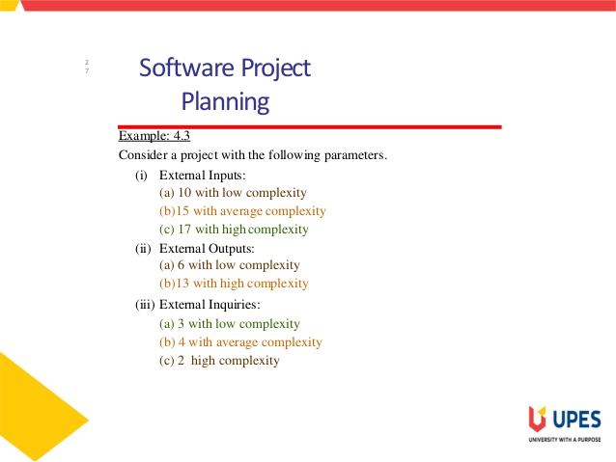

Slide 35
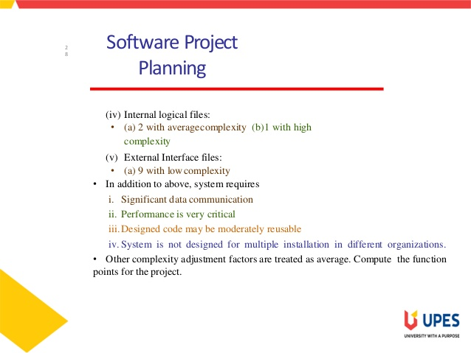

Slide 36
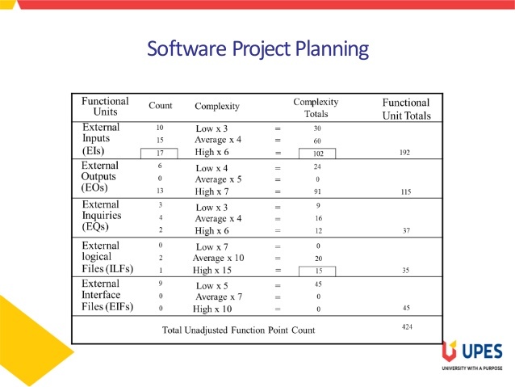

Slide 37
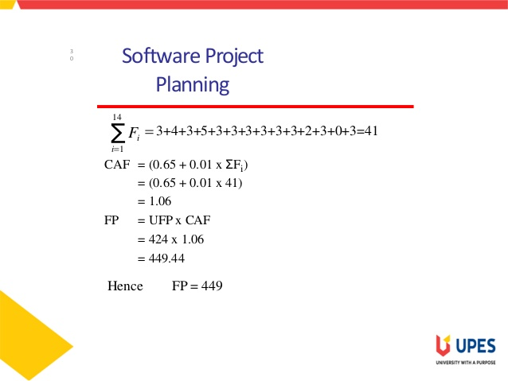

Slide 38
Function Point Controversy
Like the KLOC measure, function point use also has proponents and opponents
Proponents claim that
FP is programming language independent
FP is based on data that are more likely to be known in the early stages of a project, making it more attractive as an estimation approach
Opponents claim that
FP requires some “sleight of hand” because the computation is based on subjective data
Counts of the information domain can be difficult to collect after the fact
FP has no direct physical meaning…it’s just a number
Department of Computer Engineering, VIIT, Pune-48

Slide 39
Reconciling LOC and FP Metrics
Relationship between LOC and FP depends upon
The programming language that is used to implement the software
The quality of the design
FP and LOC have been found to be relatively accurate predictors of software development effort and cost
However, a historical baseline of information must first be established
LOC and FP can be used to estimate object-oriented software projects
However, they do not provide enough granularity for the schedule and effort adjustments required in the iterations of an evolutionary or incremental process .
The table on the next slide provides a rough estimate of the average LOC to one FP in various programming languages
Department of Computer Engineering, VIIT, Pune-48

Slide 40
LOC Per Function Point
Language | Average | Median | Low | High
Ada | 154 | -- | 104 | 205
Assembler | 337 | 315 | 91 | 694
C | 162 | 109 | 33 | 704
C++ | 66 | 53 | 29 | 178
COBOL | 77 | 77 | 14 | 400
Java | 55 | 53 | 9 | 214
PL/1 | 78 | 67 | 22 | 263
Visual Basic | 47 | 42 | 16 | 158
www.qsm.com/?q=resources/function-point-languages-table/index.html
Department of Computer Engineering, VIIT, Pune-48

Slide 41
Object-oriented Metrics
Number of scenario scripts (i.e., use cases)
This number is directly related to the size of an application and to the number of test cases required to test the system
Number of key classes (the highly independent components)
Key classes are defined early in object-oriented analysis and are central to the problem domain
This number indicates the amount of effort required to develop the software
It also indicates the potential amount of reuse to be applied during development
Number of support classes
Support classes are required to implement the system but are not immediately related to the problem domain (e.g., user interface, database, computation)
This number indicates the amount of effort and potential reuse
Department of Computer Engineering, VIIT, Pune-48

Slide 42
Object-oriented Metrics (continued)
Average number of support classes per key class
Key classes are identified early in a project (e.g., at requirements analysis)
Estimation of the number of support classes can be made from the number of key classes
GUI applications have between two and three times more support classes as key classes
Non-GUI applications have between one and two times more support classes as key classes
Number of subsystems
A subsystem is an aggregation of classes that support a function that is visible to the end user of a system
Department of Computer Engineering, VIIT, Pune-48

Slide 43
Metrics for Software Quality
Correctness
This is the number of defects per KLOC
Defects are those problems reported by a program user after the program is released for general use
Maintainability
This describes the ease with which a program can be corrected if an error is found, adapted if the environment changes, or enhanced if the customer has changed requirements
Mean time to change (MTTC) : the time to analyze, design, implement, test, and distribute a change to all users
Maintainable programs on average have a lower MTTC
Department of Computer Engineering, VIIT, Pune-48

Slide 44
Metrics for Software Quality
Integrity
Important in the age of cyber terrorists & hackers
Measures system’s ability to accidental & intentional attacks to its security
Attacks can be made on programs, data and documents.
Threat is the probability that an attack of a specific type will occur within a given time.
Security is the probability that an attack of a specific type will be resisted.
Integrity=summation of [1-(threat) * (1-security)]
Department of Computer Engineering, VIIT, Pune-48

Slide 45
Defect Removal Efficiency
Defect removal efficiency provides benefits at both the project and process level
It is a measure of the filtering ability of QA activities as they are applied throughout all process framework activities
It indicates the percentage of software errors found before software release
It is defined as DRE = E / (E + D)
E is the number of errors found before delivery of the software to the end user
D is the number of defects found after delivery
As D increases, DRE decreases (i.e., becomes a smaller and smaller fraction)
The ideal value of DRE is 1, which means no defects are found after delivery
DRE encourages a software team to institute techniques for finding as many errors as possible before delivery
Department of Computer Engineering, VIIT, Pune-48

Slide 46
Integrating Metrics within the Software Process
Department of Computer Engineering, VIIT, Pune-48

Slide 47
Arguments for Software Metrics
Most software developers do not measure, and most have little wish to begin.
Establishing a successful company-wide software metrics program can be a multi-year effort.
But if we do not measure, there is no real way of determining whether we are improving.
Measurement is used to establish a process baseline from which improvements can be assessed.
Software metrics help people to develop better project estimates, produce higher-quality systems, and get products out the door on time.
Department of Computer Engineering, VIIT, Pune-48

Slide 48
Establishing a Metrics Baseline
By establishing a metrics baseline, benefits can be obtained at the software process, product, and project levels
The same metrics can serve many masters
The baseline consists of data collected from past projects
Baseline data must have the following attributes
Data must be reasonably accurate (guesses should be avoided)
Data should be collected for as many projects as possible
Measures must be consistent (e.g., a line of code must be interpreted consistently across all projects)
After data is collected and metrics are computed, the metrics should be evaluated and applied during estimation, technical work, project control, and process improvement
Department of Computer Engineering, VIIT, Pune-48

Slide 49
Software Metrics Baseline Process
Software
Engineering
Process
Measures
Software
Project
Data
Collection
Metrics
Metrics
Computation
Software
Product
Indicators
Metrics
Evaluation
Department of Computer Engineering, VIIT, Pune-48

Slide 50
Getting Started with Metrics
Understand your existing process
Define the goals to be achieved by establishing a metrics program
Identify metrics to achieve those goals
Keep the metrics simple
Be sure the metrics add value to your process and product
Identify the measures to be collected to support those metrics
Department of Computer Engineering, VIIT, Pune-48

Slide 51
Getting Started with Metrics (continued)
Establish a measurement collection process
What is the source of the data?
Can tools be used to collect the data?
Who is responsible for collecting the data?
When are the data collected and recorded?
How are the data stored?
What validation mechanisms are used to ensure the data are correct?
Acquire appropriate tools to assist in collection and assessment
Establish a metrics database
Define appropriate feedback mechanisms on what the metrics indicate about your process so that the process and the metrics program can be improved
Department of Computer Engineering, VIIT, Pune-48

Slide 52
References
1) www.courses.psu.edu › infsy › infsy570_rxo4 › metrics › metrics
2)uomustansiriyah.edu.iq › media › lectures
3) Functional Points: https://www.slideshare.net/maalsunil/loc-and-function-point
Department of Computer Engineering, VIIT, Pune-48

Slide 53
Thank You
Department of Computer Engineering, VIIT, Pune-48

